Slide 1
Multi-Source Approach for Crowd Density Estimation in Still Images
Presented By
Deepa & Niharika
28/11/2018

Slide 2
Index
Introduction
Challenges
Perspective Distortion
Non-Linearity
Proposed Method
Experimental Results
1

Slide 3
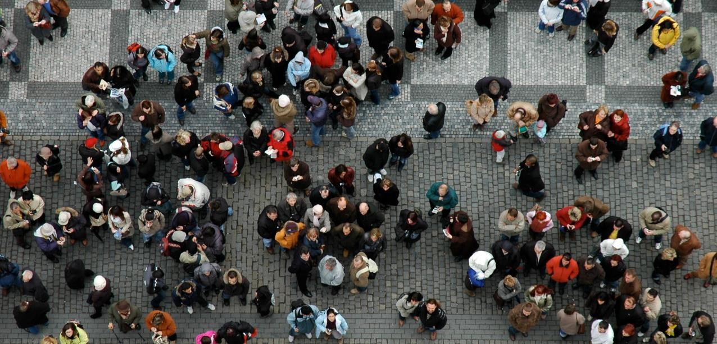
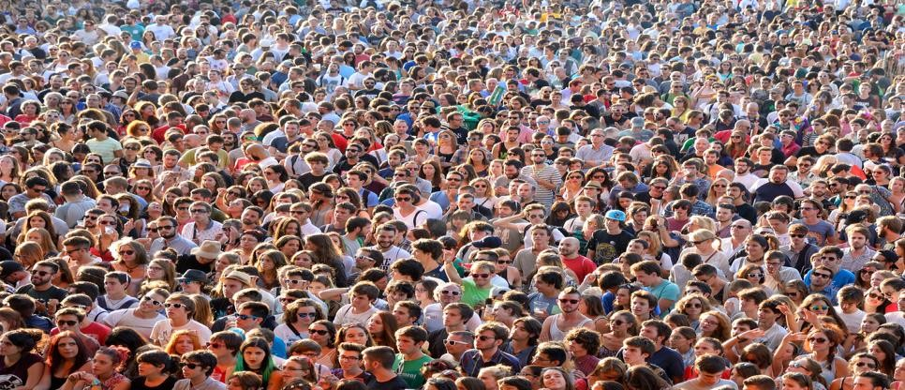
Problem Definition
Crowd Counting – Crowd Density Estimation
Introduction Challenges Proposed Method Experimental Results
Counting
Estimation
Count
Regression
2

Slide 4
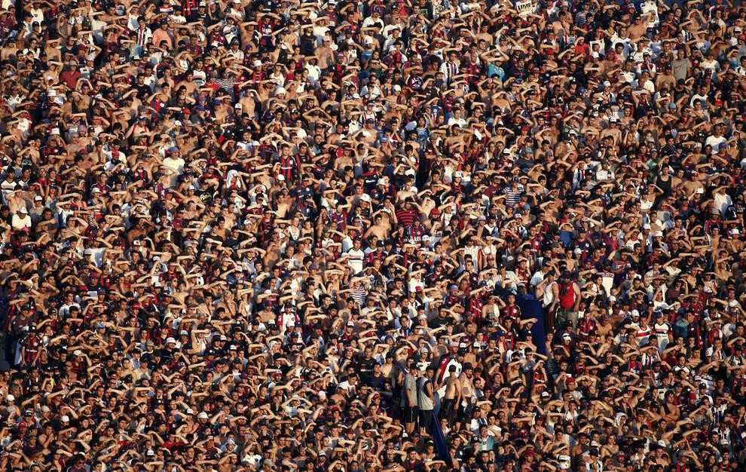
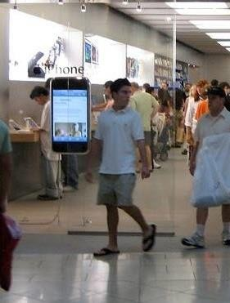
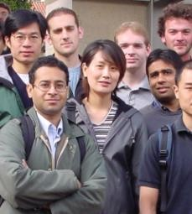
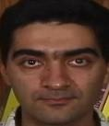
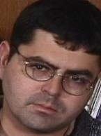

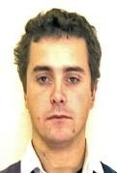
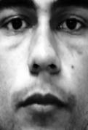
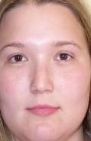
Crowd Counting Approaches
Detection-Based Crowd Counting
Introduction Challenges Proposed Method Experimental Results
Holistic
Partial
Test
Classifier
O
vercrowde Scenes
d
O
cclusion
3

Slide 5
Introduction
Challenges
Proposed Method
Experimental Results
Crowd Counting Approaches
Regression
Solves the requirements to detect and track objects.
Counting based on groups not individuals.
Depends on qualitative measures from the ability of humans to count people in crowded scenes.
Scene
Analysis Features X
Count Y
4

Slide 6
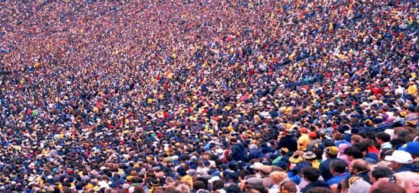
Introduction Challenges
Proposed Method
Experimental Results
Perspective Distortion
Why Perspective Distortion is a Problem?
Crowd counting in regression uses pixel count to find the people count in a region.
Due to perspective distortion, the same areas with the same size can have different people count.
P
P, X
5

Slide 7
Introduction Challenges
Proposed Method
Experimental Results
Non-Linearity
Region Pixels and People Count Relationship

Slide 8
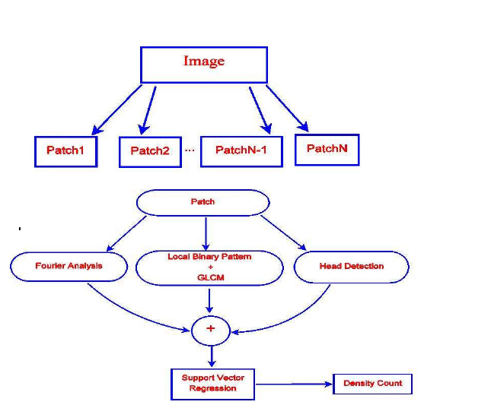
Challenges Proposed Method
Proposed Method
Introduction
Experimental Results

Slide 9

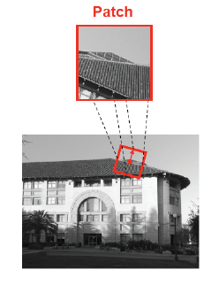
HOG
Cell (nxn pixels)
To discriminate the object form using gradient orientation.
Block(t cells)

Slide 10
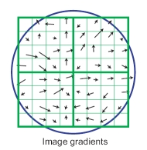
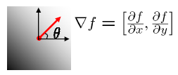
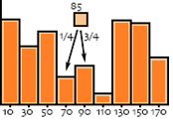
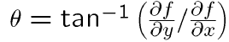
HOG
Find the edge direction at each pixel in a cell.
Count occurrences of gradient orientation in cells.
h(θ) = h(θ) +1 ; for the portion
0 to pi or 0 to 2pi; quantize to N bins
A local histogram for each cell.

Slide 11
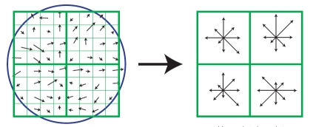
HOG
The collected histograms of cells can be agregated in a defined block
Ex: 0 to 2Pi edge orientations truncated to 16. 4 Cells per Block
Gives 16x4 = 64 features

Slide 12
Pixel Neighborhood-based Feature
The most important for texture analysis is to describe the spatial behavior of intensity values in any given neighborhood.
Different methodologies have been proposed.
Local binary pattern (LBP) is one of the most-widely used approach – mainly for face recognition.
LBP is used for texture analysis too.

Slide 13

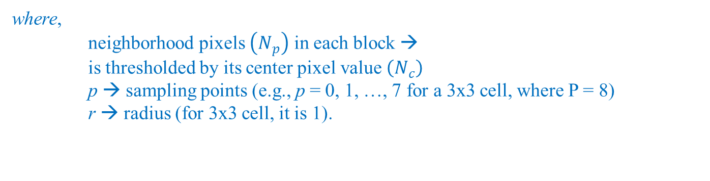
Local Binary Pattern (LBP)
For each PIXEL of an image, a BINARY CODE is produced
→ to make a new matrix with the new value (binary to decimal value).
where,
neighborhood pixels $\left(N_{p}\right)$ in each block →
is thresholdedby its center pixel value $\left(N_{c}\right)$
p→ sampling points (e.g., p = 0, 1, …, 7 for a 3x3 cell, where P = 8)
r → radius (for 3x3 cell, it is 1).
Binary threshold function $g\left(x\right)$ is,
$$g\left(x\right)=\left\{\begin{aligned}0, &x<0 \\ 1, &x≥0\end{aligned}\right.$$

Slide 14
Computation of Local Binary Pattern
Binary code for > N_{c}
0 | 1 | 0
1 | N_{c} | 0
0 | 0 | 1
 | 3 | 7 | 2
 | 8 | 4 | 1
 | 2 | 3 | 5
0 | 2 | 0
128 | ? | 0
0 | 0 | 16
∑
LBP
Component-wise multiplication
Sum
146
Representation
Neighborhood
of a gray-scale image
1 | 2 | 4
128 |  | 8
64 | 32 | 16
Example of how the LBP operator works
top

Slide 15
Co-occurrence Matrix Features
A co-occurrence matrix is a 2D array C in which
Both the rows and columns represent a set of possible
image values.
C (i,j) indicates how many times value i co-occurs with
value j in a particular spatial relationship d.
The spatial relationship is specified by a vector d = (dr,dc).
d

Slide 16
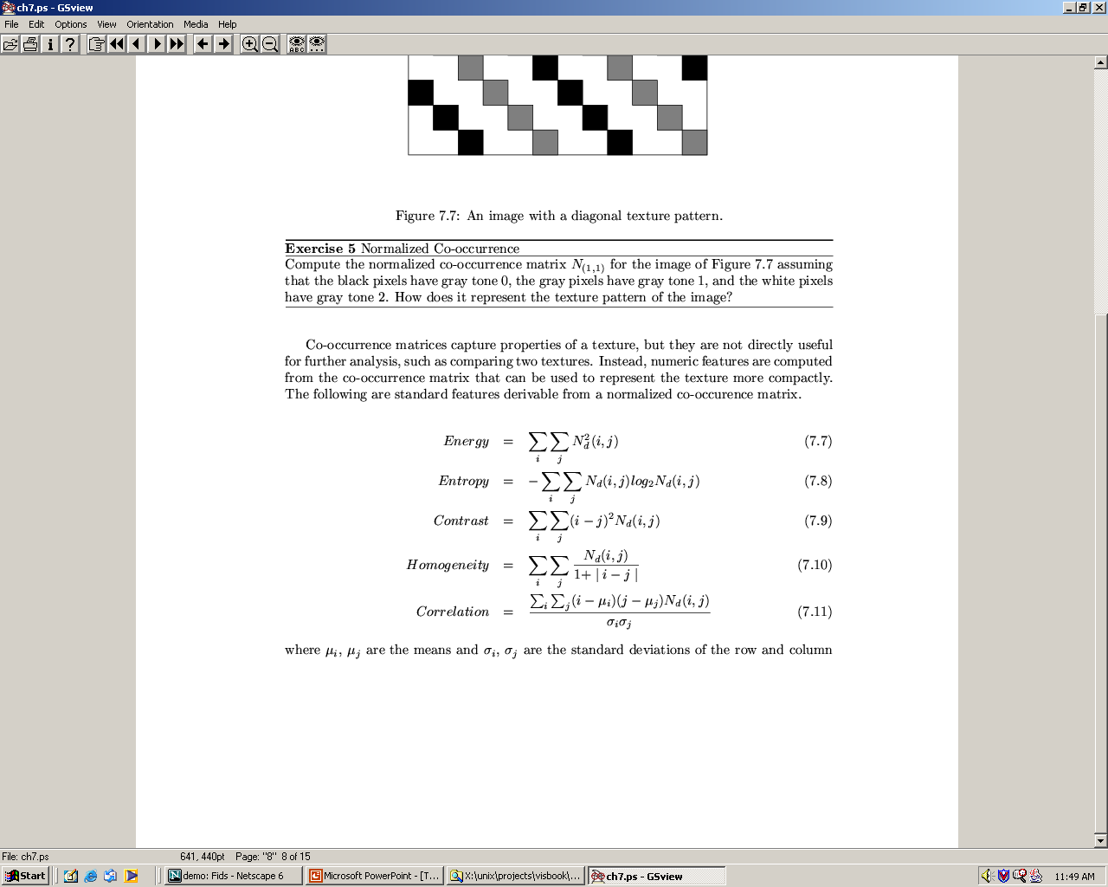
Co-occurrence Features
What do these measure?
sums.
Energy measures uniformity of the normalized matrix.

Slide 17
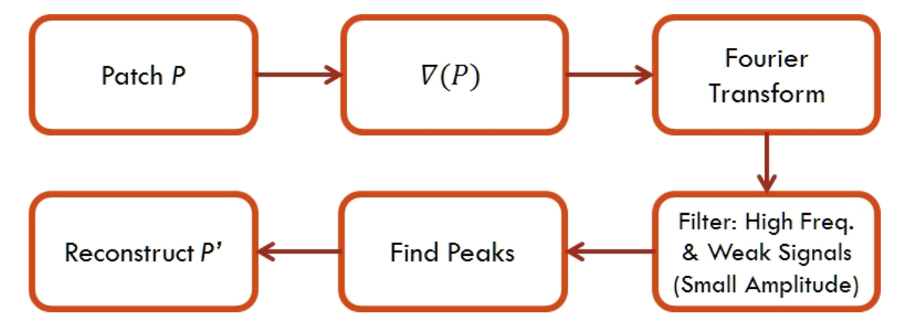
FOURIER TRANSFORM ANALYSIS
Function name : finaltokyo(im)

Slide 18
Results

Slide 19
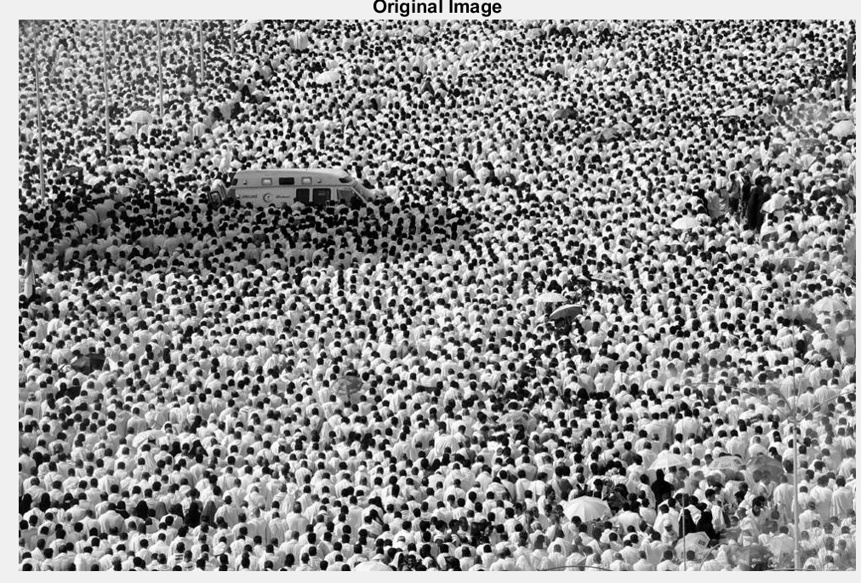
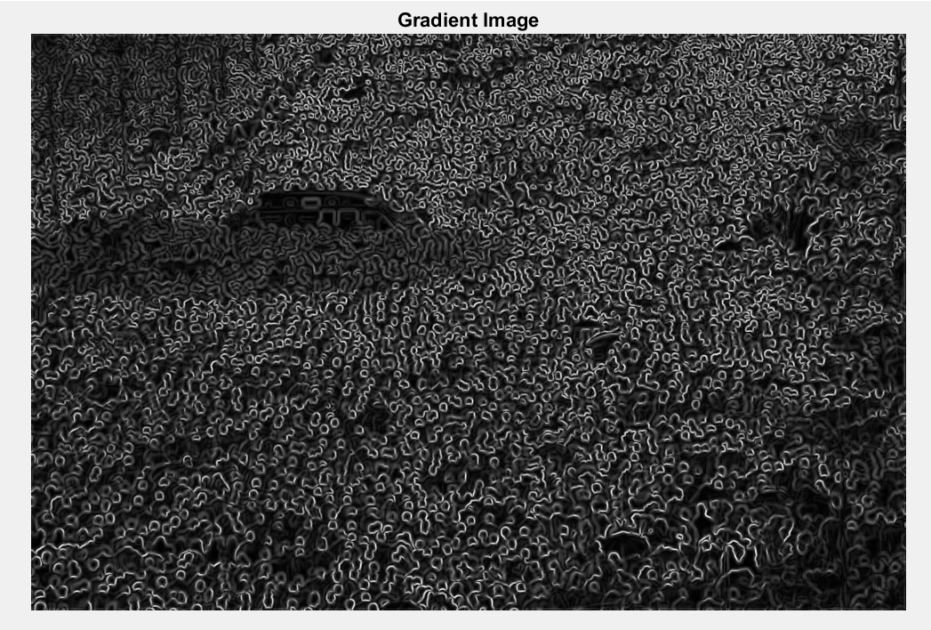
Various technigues implemented for one image :
STAGE 0 : NOISE REMOVAL
1.GAUSSIAN FILTER
2.WEINER FILTER
STAGE 1 : GRADIENT
SOBEL
CENTRAL DIFFERENCE
STAGE 3 : LOW PASS FILTERING
BUTTERWORTH FILTER
GAUSSIAN FILTER
STAGE 4: THRESHOLDING
MEAN METHOD
OTSU 'S METHOD

Slide 20
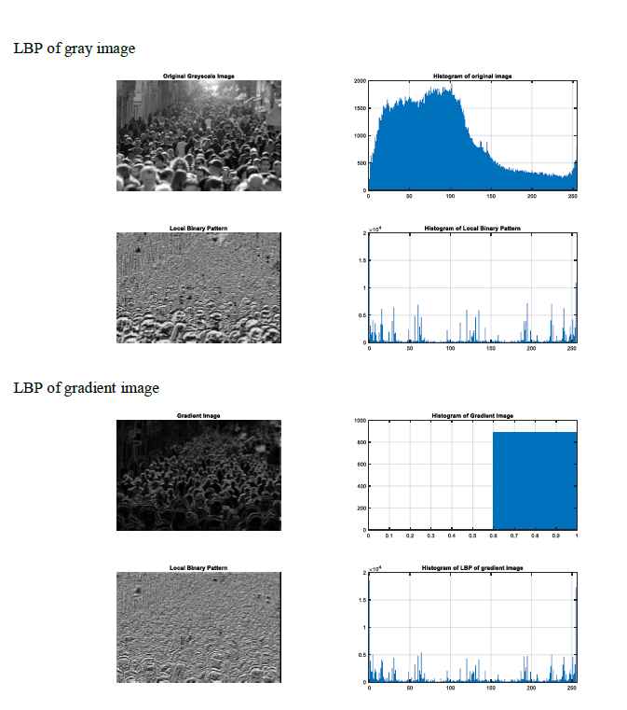
LBP

Slide 21
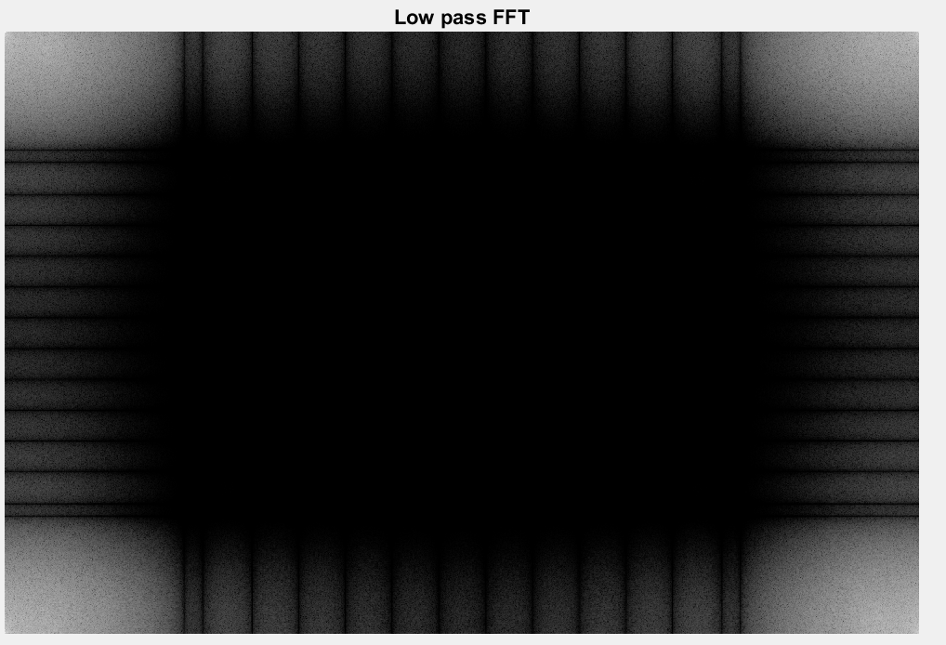
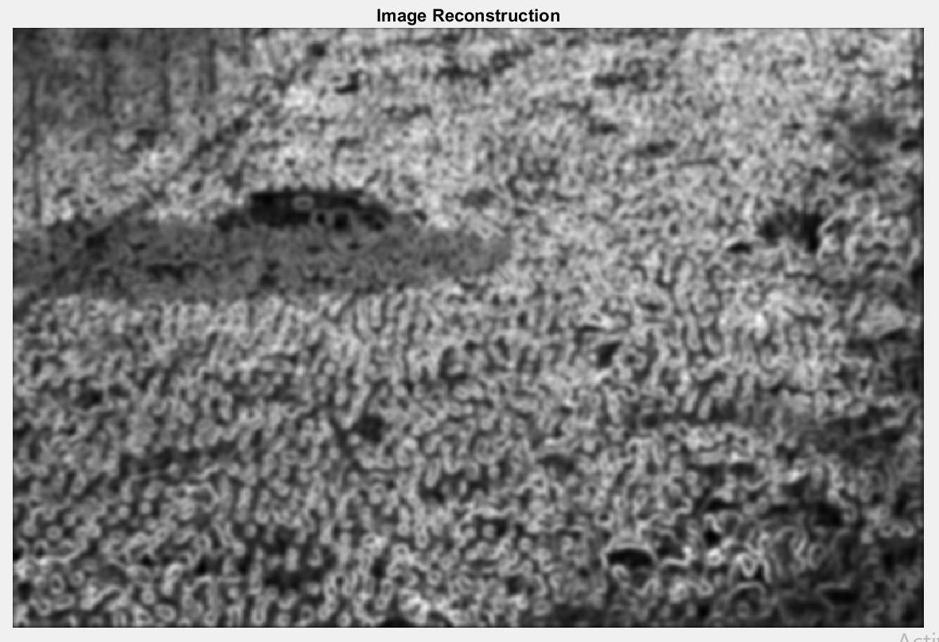
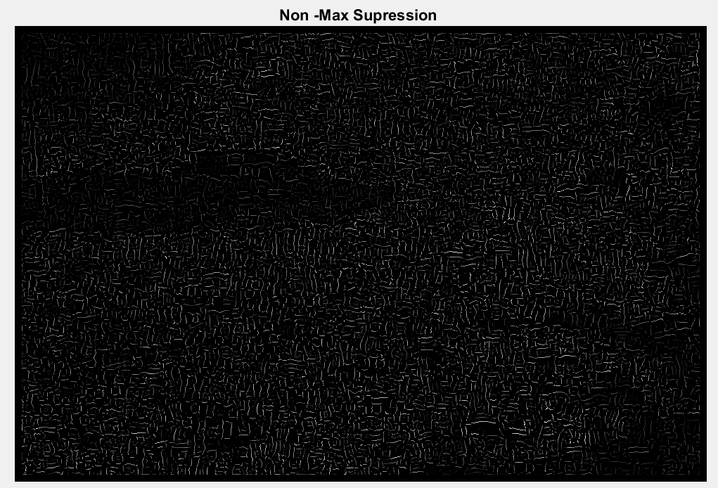

Slide 22
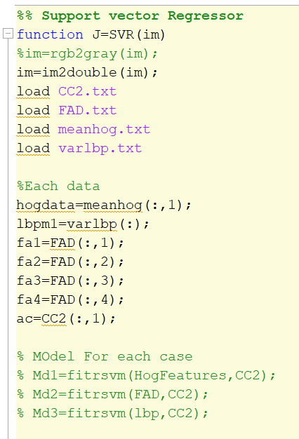
Support Vector Regression
SVR.m
Trained 3 Models for HOG ,LBPM,GLCM - Md1,Md2,Md3 .
Combined Regressor – MODEL
Combination of data :
-Variance of HOG,LBP .
-Fourier Transform : Kurtosis,Mean,Entropy,etc.
Used IMAGE BLOCK Processor for generating all the outputs .
Data taken :UCF 50 Crowd Density

Slide 23
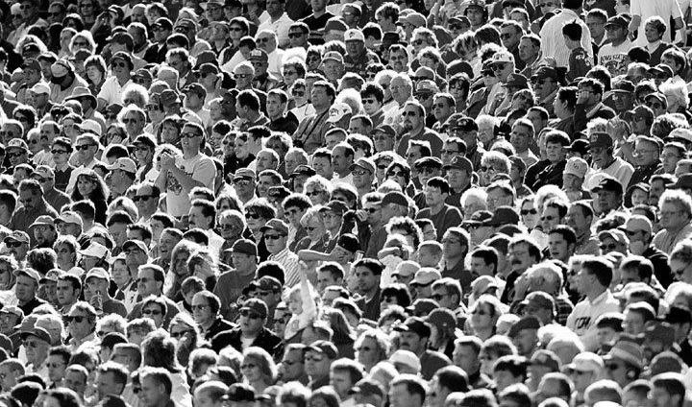
RESULTS :
SVM Estimator :
1208 counts
Ground Truth :
740

